Slide 1
Landau-Zener-Stückelberg-Majorana (LZSM) transitions for interferometry and quantum control
Oleh V. Ivakhnenko¹, Sergey N. Shevchenko^{1, 2} and Franco Nori ^{3, 4}
¹Institute for Low Temperature Physics and Engineering, Kharkiv, Ukraine
²Kharkiv National University, Kharkiv, Ukraine
³RIKEN, Japan
⁴University of Michigan, Ann Arbor, USA
This research is sponsored by the Army Research Office
For details: O. V. Ivakhnenko, S. N. Shevchenko, F. Nori, "Quantum Control via Landau-Zener-Stückelberg-Majorana Transitions ", in preparation (2022).
Notes:
*Упоминание гранта. *Ссылка на обзор. For details see Ref 1. поменять название обзора.

Slide 2
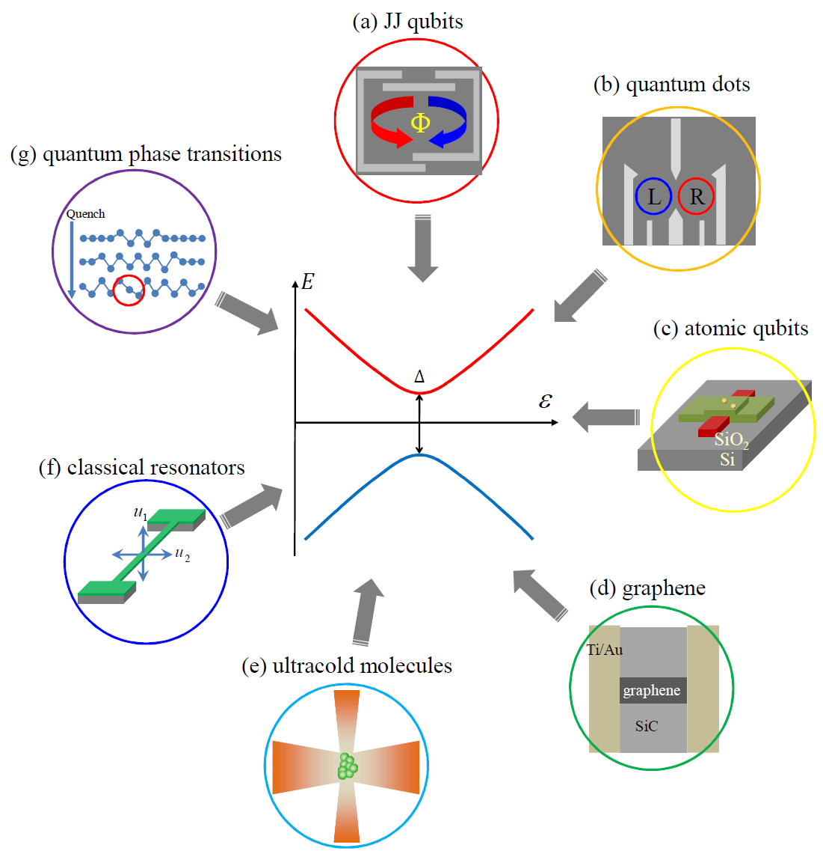
Two-Level Systems
Many different systems behave as driven qubits
Two-level systems are important in quantum mechanics.
When driven, such systems experience transitions, which are important for both system characterization and control.
Qubit state:
Hamiltonian of a qubit:
Notes:
*Двухуровневая система одна из базовій и распротсраненніх в природе

Slide 3
Energy levels of two-level system
We solve the “adiabatic” Schrödinger equation
Thus, we obtain the adiabatic energy levels:
Energy difference:
E
Single passage
E
Double passage
E
Cyclic driving
(a)
(b)
(c)
P₊
P_{LZSM}
P_{St}
Δ
Δ
Δ
0
ε(t)
0
ε(t)
0
ε(t)
t
t
t
Notes:
-Подровнять
*Подписать single passage Double multiple
*Dynamics of energy levels
E(t) Three regimes of driwing

Slide 4
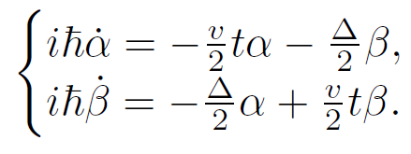
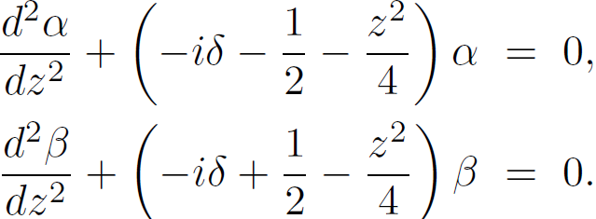
Dynamics: Zener’s approach
This is the most general approach,
which provides analytical results
for both probability and phases,
when there is a linear excitation.
Schrödinger equation:
The second-order differential equations for parabolic cylinder special functions
time variable
where
parameter of adiabaticity
Solution in terms of parabolic-cylinder Weber functions
where
For Majorana’s approach: see poster P. Kofman et al. G00.00187
Using the asymptotics we find probability
and phase change
Notes:
There are different approaches ref. Polina G00.00186
*Включить уравнение Шредингира
*Определить delta и P_lzsm
Порезать слова на слайде. Tau записать в Z И добавить определение \delta Zener time немного переписать

Slide 5
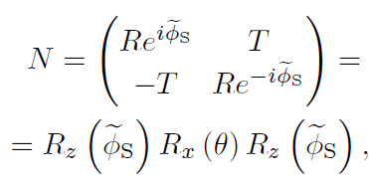
Landau-Zener-Stückelberg-Majorana (LZSM) transition:
Transfer Matrix (TM) Evolution
Adiabatic (transitionless) between transitions
Diabatic (transition, impulse)
Reflection:
Excitation probability:
Transmission:
Stokes phase:
Total evolution matrix for a single LZSM transition:
Notes:
Определить P_LZSM и привести их к одному виду по всей презентации.
Разным цветом адиаб и диаб. эволюция

Slide 6
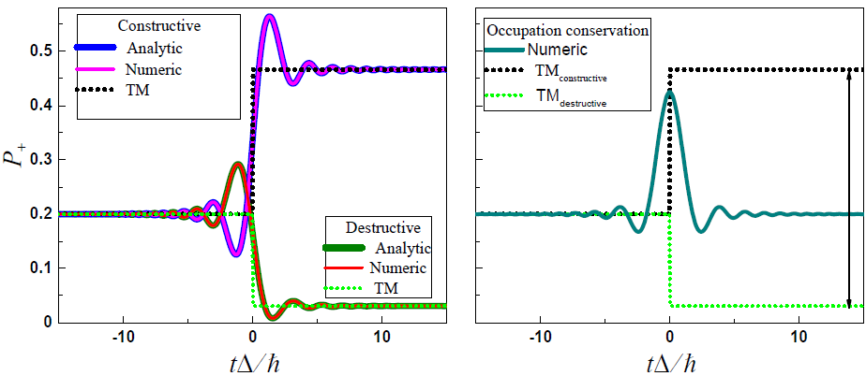
Occupation conservation transition
Consider the superposition initial condition:
where is the initial phase difference.
From the total evolution matrix we find the final occupation probability
Initial occupation probability is included in the range of possible values
of the final occupation probability, which is defined by varying
Notes:
*Occepation conservati on check. 2 in one slide.
*3 box simpler
*Возможно обьеденить со следующим слайдом. Рисунок со вторім боксом

Slide 7
Repetitive (or cyclic) passage
Energy levels Driving signal
Transition moments and
Notes:
Возможно разделить на 2 слайда 1. смысл АИМ 2. результат АИМ. Adiabatic Impulse Model
подвигать

Slide 8
Repetitive (or cyclic) passage
Time moments of transition evolution
and
Adiabatic evolutions:
One-period evolution matrix
Dynamics of upper level occupation probability
Notes:
Возможно разделить на 2 слайда 1. смысл АИМ 2. результат АИМ. Adiabatic Impulse Model

Slide 9
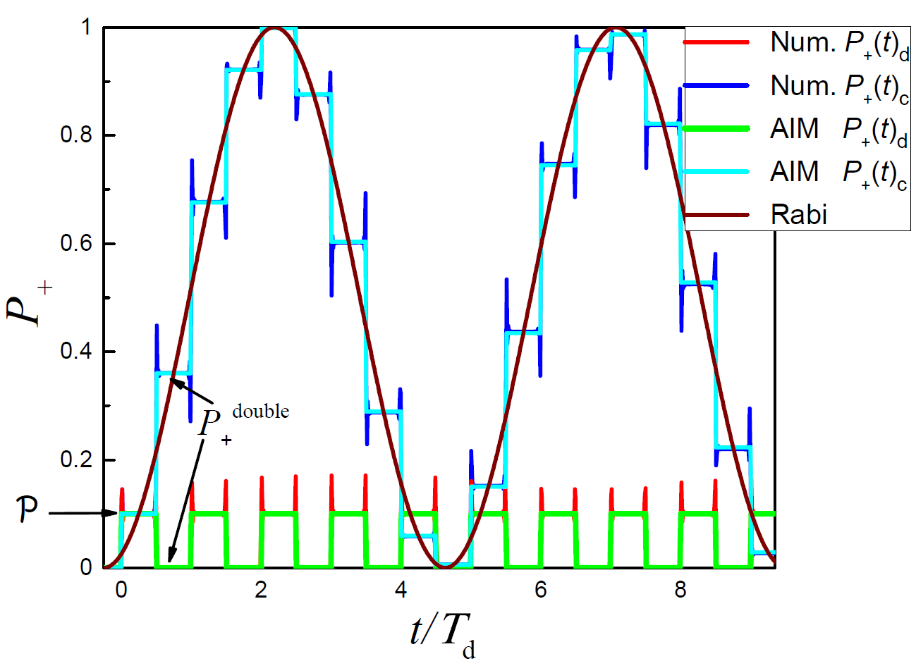
Dynamics of the upper-level occupation probability with repetitive passage can be used to control quantum systems
Rabi frequency in the Adiabatic Impulse Model (AIM)
Constructive condition
Destructive condition
Notes:
This is needed for control quantum systemd Поставить P_lzsm

Slide 10
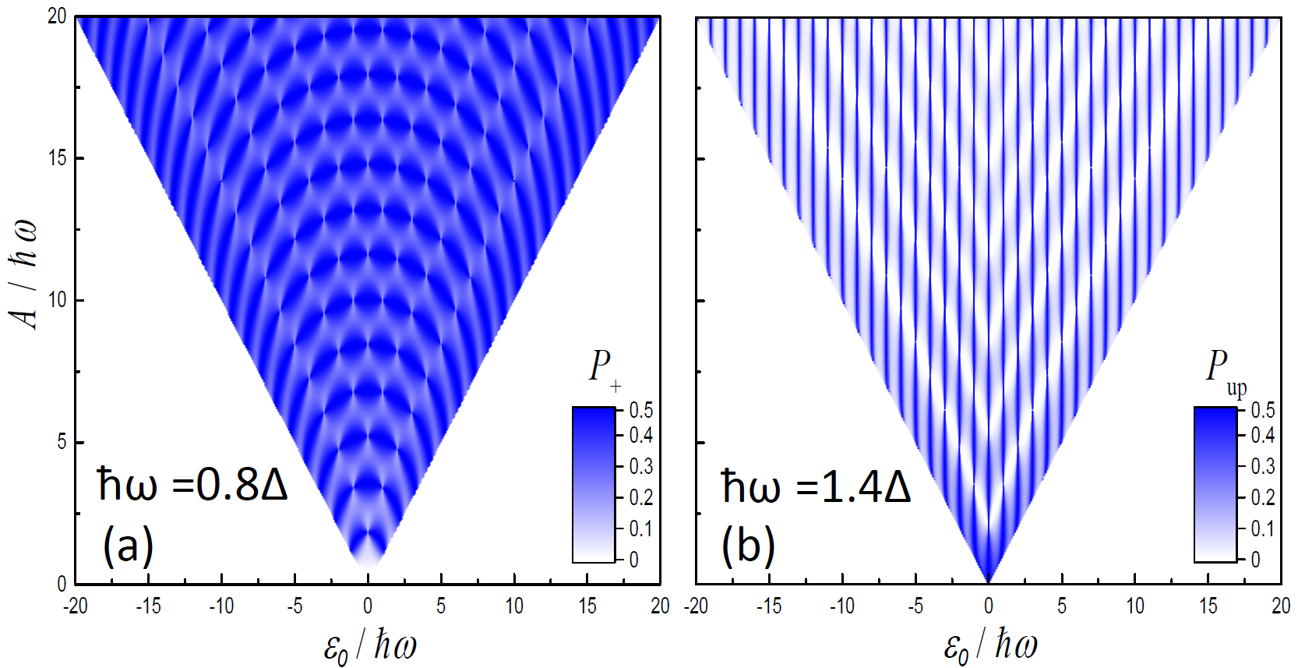
INTERFEROMETRY: Averaged probability
can be used to obtain parameters of the system
Adiabatic limit
Diabatic limit
Notes:
It’s needs to getting parameters of the system
Сделать одинаковые P

Slide 11
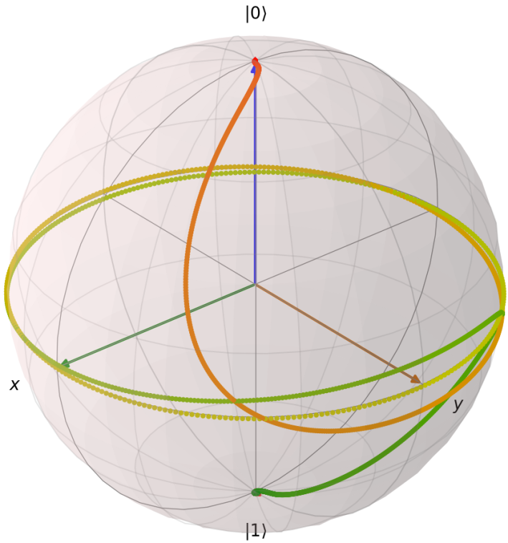
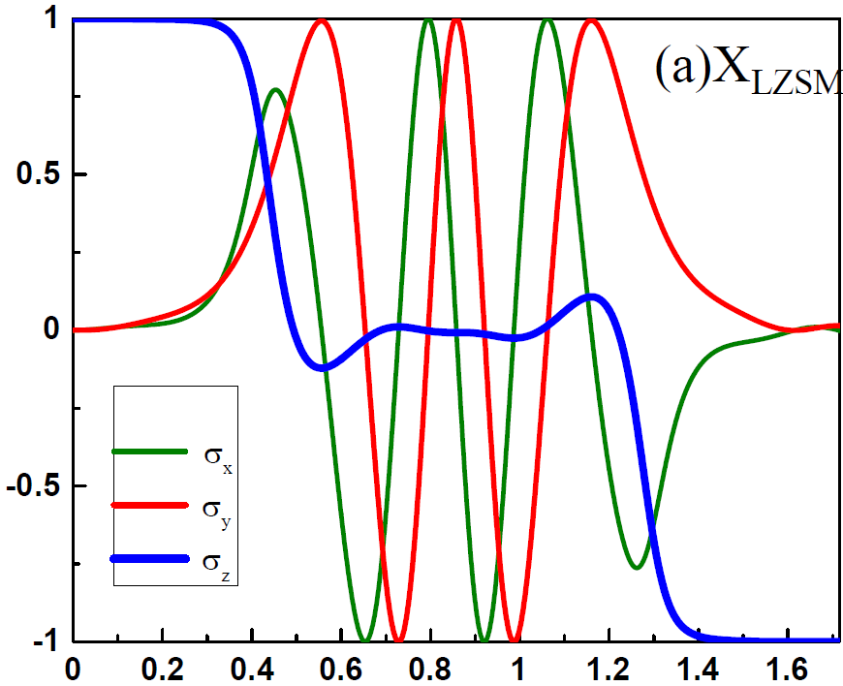
Quantum LZSM gate
Quantum gates can be realized using LZSM transitions.
For example, consider realization of X (NOT) gate via two LZSM transitions with constructive interference.
Dynamics on Bloch sphere
Dynamics in Bloch coordinates
Experiment: see Campbell et al., PRX (2020). Theory: see the next talk A. Ryzhov et al. Q38.00011
Notes:
*References Campbell and Artem
Закрасить вторую единицу
ПОДВИГАТЬ

Slide 12
Summary
LZSM transitions can display: constructive enhancement, destructive suppression, and occupation conservation
P₊
Δ
For details see: O. V. Ivakhnenko, S. N. Shevchenko, F. Nori,
"Quantum Control via Landau-Zener-Stückelberg-Majorana Transitions ", in preparation (2022).
Notes:
*Less words more figures. Сменяющие друг друга картинки. 1 и 3 обьединить. 2 разбить на 2. Разбить на 2 слайда 3 вывода
Показать сначала 2 рисунка а потом третий.

Slide 13
Summary
LZSM transitions can display: constructive enhancement, destructive suppression, and occupation conservation
An avoided-level crossing includes adiabatic evolution,
non-adiabatic transitions, and quantum interference.
LZSM model is an important tool for characterizing and controlling quantum systems.
P₊
Δ
For details see: O. V. Ivakhnenko, S. N. Shevchenko, F. Nori,
"Quantum Control via Landau-Zener-Stückelberg-Majorana Transitions ", in preparation (2022).
Notes:
*Less words more figures. Сменяющие друг друга картинки. 1 и 3 обьединить. 2 разбить на 2. *Разбить на 2 слайда 3 вывода
Калибровка и контроль.

